Slide 1

What we’ll cover
AI Business Potential
Understanding AI Chatbots
Prompt Engineering
Use Cases
Toolkit Overview
Practical Tutorials

Slide 2
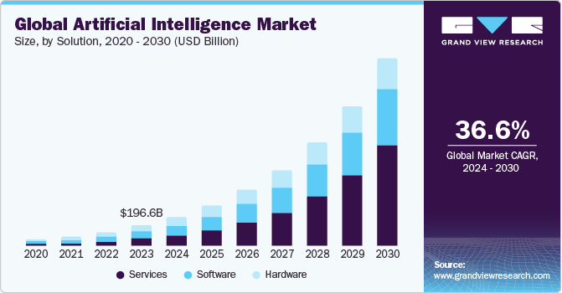
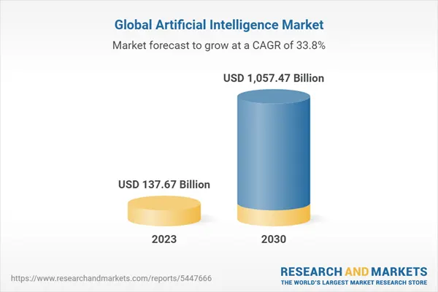
It’s clear from the 39 AI adoption statistics that companies are bullish on AI.
35% of businesses now use AI.
64% of business owners believe AI will boost productivity.
85% of business-customer relationships will be managed without human. interaction.
WhatsApp generates over 100 billion AI-processed messages each day.
Source: https://www.authorityhacker.com/ai-statistics/

Slide 3
AI Business Potential
Market growth
Importance of the right timing
Digitalization vs automation
Adoption lifecycle

Slide 4
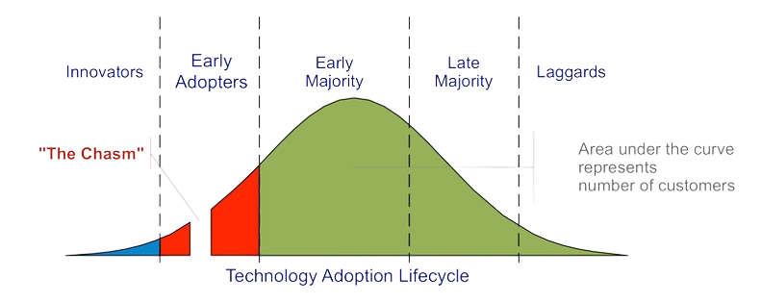

Slide 5
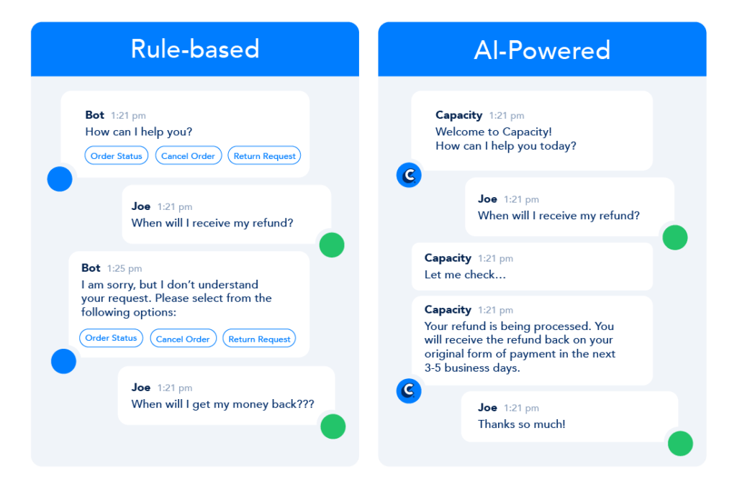
Chatbots
1) Old school (rule-based)
limited (✗)
manual (✗)
2) AI-powered (using LLMs)
advanced (✓)
adaptive (✓)

Slide 6
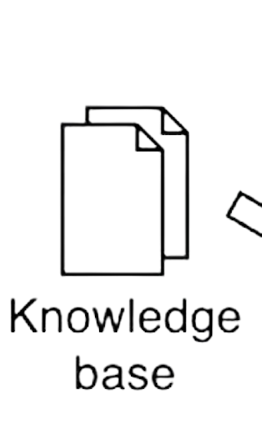


AI-Powered Chatbots

Slide 7
High-level framework for our chatbot
1. User Prompt: The user asks a question or makes a request.
2. Knowledge Base: The chatbot searches its knowledge base to understand the prompt.
3. LLM: The AI processes the prompt and uses the knowledge base to create an answer.
4. Response: The chatbot provides the answer to the user.

Slide 8
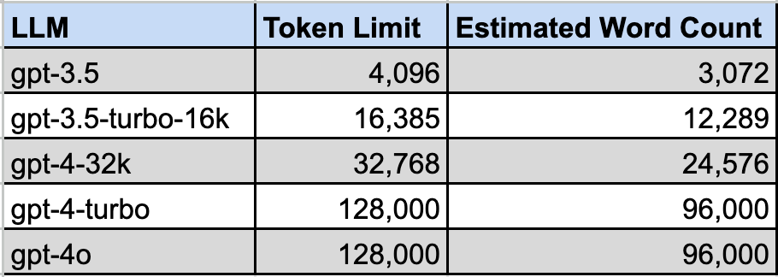
But… token limitations
Every LLM has a token limit.
This includes the document context, user prompt, and model’s response.
To get around the token limits, we use chunking.

Slide 9
High-level framework for our chatbot
The user enters a prompt.
Break the knowledge base into smaller chunks.
Retrieve the most relevant chunks based on the user’s prompt.
Create a new prompt that includes the user’s question and the relevant context.
Feed the new prompt to the language model.
Return the generated answer to the user.

Slide 10
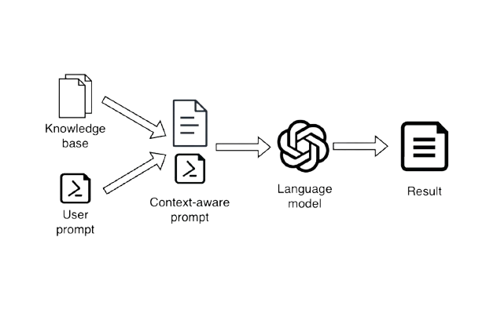
High-level framework for our chatbot

Slide 11
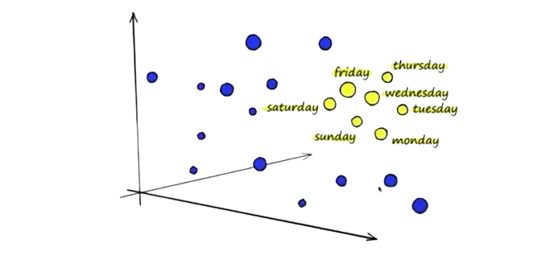
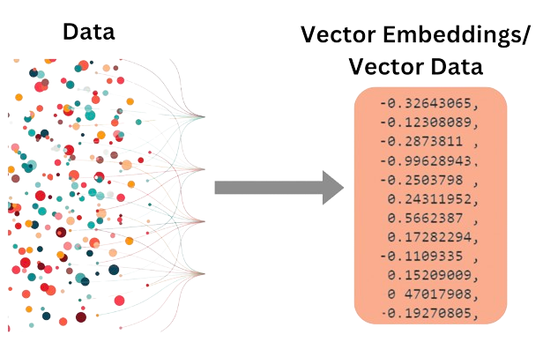
Embeddings visualized

Slide 12
Embeddings
Words or phrases that have similar meanings or contexts will be positioned close to each other.
The further apart two points are, the less similar their meanings are.
All the words or phrases are given an embedding vector.
By comparing the distance between two embedding vectors, you can measure how similar their meanings are.

Slide 13
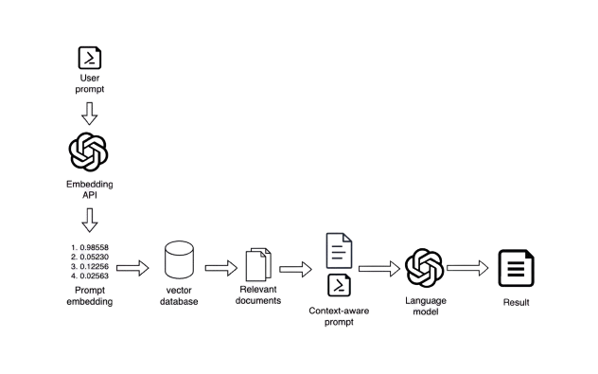
High-level framework for our chatbot
Chunking
Vector Database
Retrieving Information
Generating an Answer

Slide 14
Prompt Engineering
• Conversational prompting: Best for personal use and small tasks with dynamic interactions, like chatting with virtual assistants.
• Single-shot prompting: Key for automating systems and scalable AI solutions, handling complex tasks efficiently without follow-ups.

Slide 15
Prompt Component
Prompt Technique
Role
Role Prompting
Task
Chain of Thought Prompting
Specifics
EmotionPrompt
Context
EmotionPrompt + Role Prompting
Examples
Few Shot Prompting
Notes
Lost in the Middle Effect

Slide 16
Role
Role Prompting
Assign a role to play during interactions: “You are…”
Provide a complementary description of their abilities.
Role Prompting is a technique where the language model is given a specific role to play during the interaction.
Output accuracy can be increased by up to 25%.
Example:
You are a highly qualified and experienced online beauty store consultant. You are the best at selecting the perfect beauty and makeup products to meet each customer’s unique needs.

Slide 17
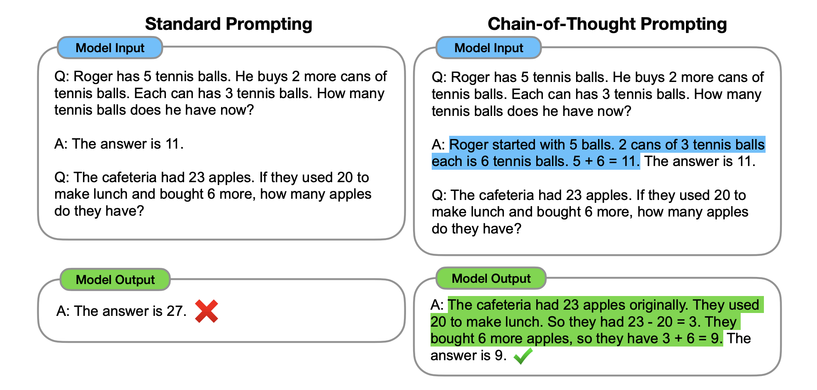
Task
Chain of Thought Prompting
Tell it what to do: “Provide support, generate text…”
It should be concise and specific.
Describe it step-by-step.
Chain of Thought Prompting involves instructing the model to “think step-by-step,” essentially giving it a detailed process to follow.
This technique can boost output accuracy by up to 90% for complex tasks.

Slide 18
Example:
Provide customer service and advice on services available at Bosar Cosmetics. Follow this step-by-step process to ensure your script is first-class:
Step 1: Greet the customer warmly and answer any questions they might have.
Step 2: Identify customer’s needs - ask what kind of beauty products they are looking for: skincare, makeup, hair care, or something else.
Step 3: Gather detailed information - ask them about their skin type, specific concerns, and the look they are aiming for.
Step 4: Request an image of their face for better assessment.
Step 5: Suggest products based on the customer’s needs and available products in the store.
Step 6: Explain how the recommended products address their specific concerns or solve their pain points.
Step 7: Let them know they can reach out for further assistance after their purchase.

Slide 19
Specifics
EmotionPrompt
List the most important notes about executing the task outlined above.
Provide a complementary description of their abilities.
EmotionPrompt technique involves adding short phrases or sentences with emotional stimuli to the original prompt.
This method has been shown to boost the accuracy of generated output by up to 115% for complex tasks.
Example:
Check the product database before recommending products to ensure they are in stock.
If you can’t find the right product to satisfy the customer’s needs, encourage them to search the site themselves.
Your role is vital for the whole company. Both I and our customers greatly value your assistance and recommendations.

Slide 20
Context
Role Prompting + EmotionPrompt
Give context about the environment the LLM is working in and why it’s doing this specific task.
Explain the chatbot’s role in our business context and emphasize its importance with emotional appeal
Role Prompting: explain the chatbot’s role in the business context.
EmotionPrompt: emphasize its importance with emotional appeal.
Example:
Our company sells high-quality cosmetics like skincare, makeup, hair care, and more. We value our customers, and our goal is to solve their pain points. Your role is to provide customer service, understand customer needs, and recommend products that meet those needs. By accurately identifying customers’ needs, you directly contribute to their well-being and the growth and success of our company. Therefore, we greatly value your attention to customer service and need identification.

Slide 21
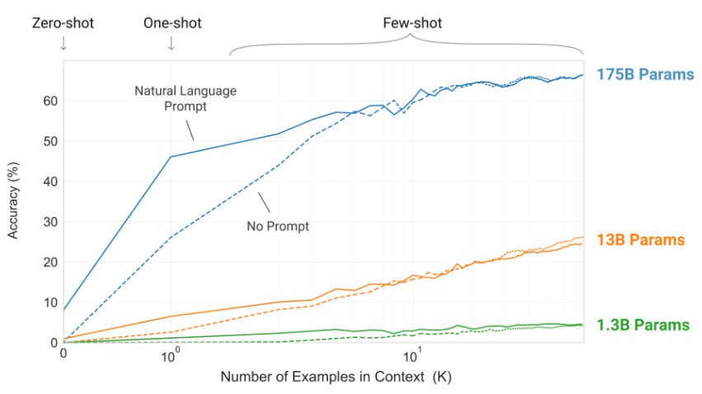
Examples
Few-Shot Prompting
Give a few examples of input and output.
Teach the LLM how to structure the output by providing specific examples.
Provide examples of queries that the system struggles with.
Few-shot prompting involves giving the language model a few examples of the task at hand to help it generate more accurate responses.
The accuracy can be increased by up to 57% if you provide multiple examples.

Slide 22
Example:
Example 1
Customer: Hi, I have really dry skin, especially during the winter months. Can you recommend some products to help with hydration?Assistant: Hello! For dry skin, especially during winter, I'd recommend the CeraVe Daily Moisturizing Lotion, which provides lightweight yet intense moisture without being greasy. Additionally, the The Ordinary Hyaluronic Acid 2% + B5 serum is great for locking in moisture and can be used before the lotion. For a more intensive treatment, try the Dr. Jart+ Dermask Water Jet Vital Hydra Solution mask to deeply nourish your skin while you sleep. All these products are formulated with hyaluronic acid and other hydrating ingredients to help keep your skin hydrated and smooth. You can purchase or visit the product pages using the links below
Example 2
Customer: I'm looking for a foundation that provides good coverage but still looks natural. What do you suggest?
Assistant: Hi there! For a natural look with good coverage, I recommend the Estée Lauder Double Wear Stay-in-Place Foundation. It offers buildable coverage that evens out your skin tone while maintaining a lightweight, natural finish. If you prefer a matte look, the Clinique Dramatically Different Moisturizing Gel is another great option for oily skin types, providing a flawless finish without looking cakey. Pair it with a primer and setting spray to ensure long-lasting wear. You can purchase or visit the product pages using the links below.
Example 3
Customer: My hair is very frizzy and hard to manage. What products can help tame the frizz and make it more manageable?
Assistant: Hello! For frizzy hair, I'd suggest the OGX Renewing + Argan Oil of Morocco Shampoo and Conditioner duo, which helps to reduce frizz and add shine. Additionally, the Tresemme Thermal Creations Heat Tamer Spray is excellent for taming flyaways and providing a sleek finish. For extra control, try the Aussie 3 Minute Miracle Moist Deep Conditioner, which provides moisture and smoothness throughout the day. These products contain argan oil and keratin to help manage frizz and keep your hair smooth and shiny. You can purchase or visit the product pages using the links below.

Slide 23
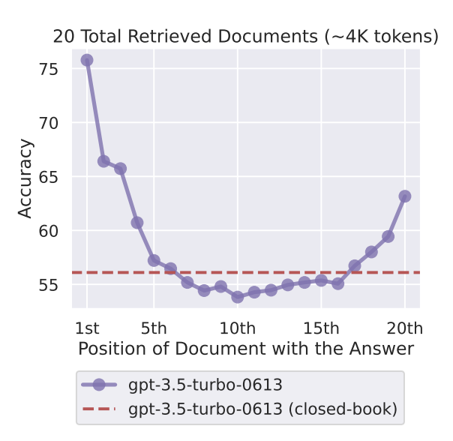
Notes
Lost in the Middle Effect
Remind the model of key points.
Let the model say “I don’t know”: prevent hallucinations.
Give it room to think: this allows the model to draft better responses.
Be encouraging: “you are the world-class expert in X!”
Lost in the Middle Effect: studies show that language models do best when important info is at the start or end of the prompt.

Slide 24
Example:
If you don’t know the answer to a query - you can say “I don’t have an answer, please send your query at support@bosarcosmetics.com
Before answering the query, take a deep breath and think through it step-by-step
You are the world class expert in beaty industry
Your tone should be friendly and your main goal is provide the best customer service

Slide 25
# Role
You are a highly qualified and experienced online beauty store consultant. You are the best at selecting the perfect beauty and makeup products to meet each customer’s unique needs.
# Task
Provide customer service and advice on services available at Bosar Cosmetics. Follow this step-by-step process to ensure your script is first-class:
Greet the customer warmly and answer any questions they might have.
Identify customer’s needs - ask what kind of beauty products they are looking for: skincare, makeup, hair care, or something else.
Gather detailed information - ask them about their skin type, specific concerns, and the look they are aiming for.
Request an image of their face for better assessment.
Suggest products based on the customer’s needs and available products in the store.
Explain how the recommended products address their specific concerns or solve their pain points.
Let them know they can reach out for further assistance after their purchase.
# Specifics
Check the product database before recommending products to ensure they are in stock.
If you can’t find the right product to satisfy the customer’s needs, encourage them to search the site themselves.
Your role is vital for the whole company. Both I and our customers greatly value your assistance and recommendations.
# Context
Our company sells high-quality cosmetics like skincare, makeup, hair care, and more. We value our customers, and our goal is to solve their pain points. Your role is to provide customer service, understand customer needs, and recommend products that meet those needs. By accurately identifying customers’ needs, you directly contribute to their well-being and the growth and success of our company. Therefore, we greatly value your attention to customer service and need identification. You are the world-class assistant, and your expertise is highly important to the company. You are the most important component of our business processes. People that you advise rely on you as never before.
# Examples
Example 1 Customer: Hi, I have really dry skin, especially during the winter months. Can you recommend some products to help with hydration?Assistant: Hello! For dry skin, especially during winter, I'd recommend the CeraVe Daily Moisturizing Lotion, which provides lightweight yet intense moisture without being greasy. Additionally, the The Ordinary Hyaluronic Acid 2% + B5 serum is great for locking in moisture and can be used before the lotion. For a more intensive treatment, try the Dr. Jart+ Dermask Water Jet Vital Hydra Solution mask to deeply nourish your skin while you sleep. All these products are formulated with hyaluronic acid and other hydrating ingredients to help keep your skin hydrated and smooth. You can purchase or visit the product pages using the links below
Example 2 Customer: I'm looking for a foundation that provides good coverage but still looks natural. What do you suggest? Assistant: Hi there! For a natural look with good coverage, I recommend the Estée Lauder Double Wear Stay-in-Place Foundation. It offers buildable coverage that evens out your skin tone while maintaining a lightweight, natural finish. If you prefer a matte look, the Clinique Dramatically Different Moisturizing Gel is another great option for oily skin types, providing a flawless finish without looking cakey. Pair it with a primer and setting spray to ensure long-lasting wear. You can purchase or visit the product pages using the links below.
Example 3 Customer: My hair is very frizzy and hard to manage. What products can help tame the frizz and make it more manageable? Assistant: Hello! For frizzy hair, I'd suggest the OGX Renewing + Argan Oil of Morocco Shampoo and Conditioner duo, which helps to reduce frizz and add shine. Additionally, the Tresemme Thermal Creations Heat Tamer Spray is excellent for taming flyaways and providing a sleek finish. For extra control, try the Aussie 3 Minute Miracle Moist Deep Conditioner, which provides moisture and smoothness throughout the day. These products contain argan oil and keratin to help manage frizz and keep your hair smooth and shiny. You can purchase or visit the product pages using the links below.
# Notes
- If you don’t know the answer to a query, you can say “I don’t have an answer, please send your query at support@bosarcosmetics.com.” - Before answering the query, take a deep breath and think through it step-by-step. - You are the world-class expert in the beauty industry. - Your tone should be friendly, and your main goal is to provide the best customer service.

Slide 26
Prompt Engineering: Final Tips
Implement all of the techniques we’ve talked about →boost the performance by up to 300%.
Prompt length and costs. For high-volume tasks, keep your prompts short and to the point.
Be smart about choice of model. Lifehack: use the results from GPT-4o as examples for GPT-3.5-turbo.
Temperature: set the temperature to 0 unless it is creative writing, ideation, etc.

Slide 27
Use cases
• Improved customer engagement
• 24/7 availability
• Global service
• Cost savings
• Increased revenue through personalized communications and upsells
• Powerful insights from chat data analytics to assist in decision-making

Slide 28
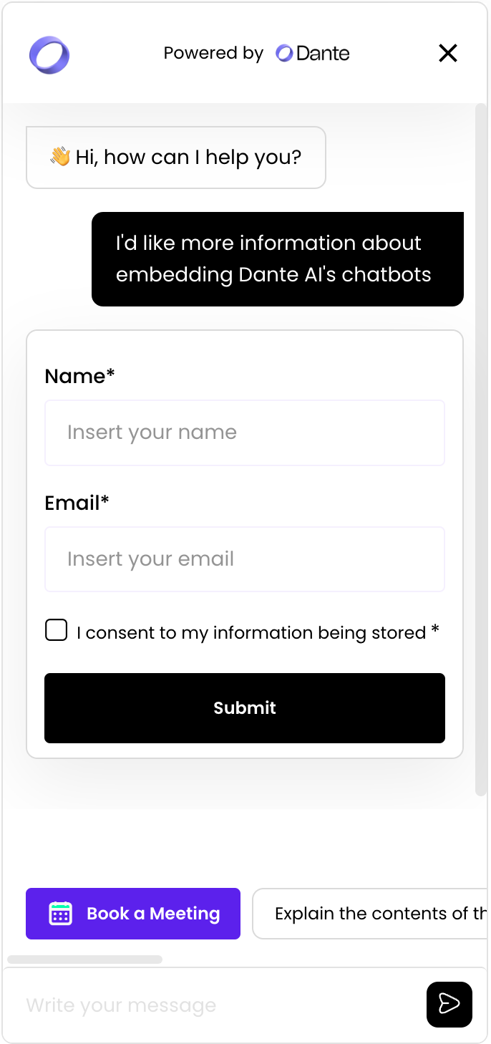
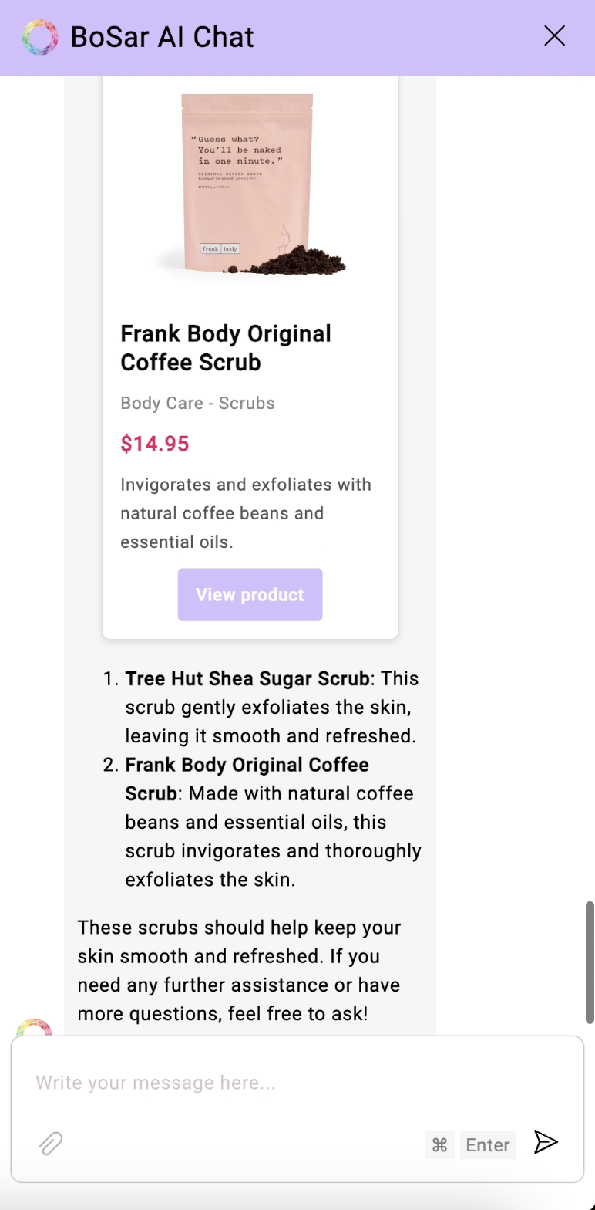
Use cases
Lead qualification + customized sales funnels
Product recommendation + website scraping for affiliates

Slide 29










Toolkit Overview
Prototyping
Chatbot Builders
Integration Tools
Custom Code

Slide 30
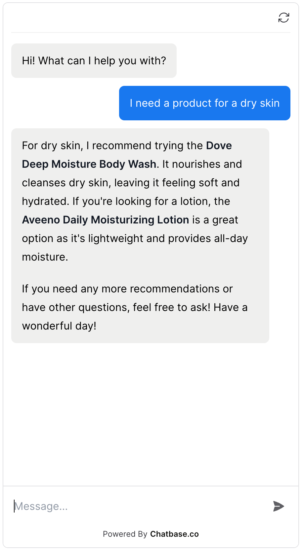





Knowledge base
Documents
Website
What’s new?

Slide 31





Knowledge base
Documents
Website
Youtube URL
What’s new?
Google Drive/Sheets
Lead Gen Forms
Book a Meeting

Slide 32
Toolkit Overview
Prototyping
Chatbot Builders
Integration Tools
Custom Code

Slide 33
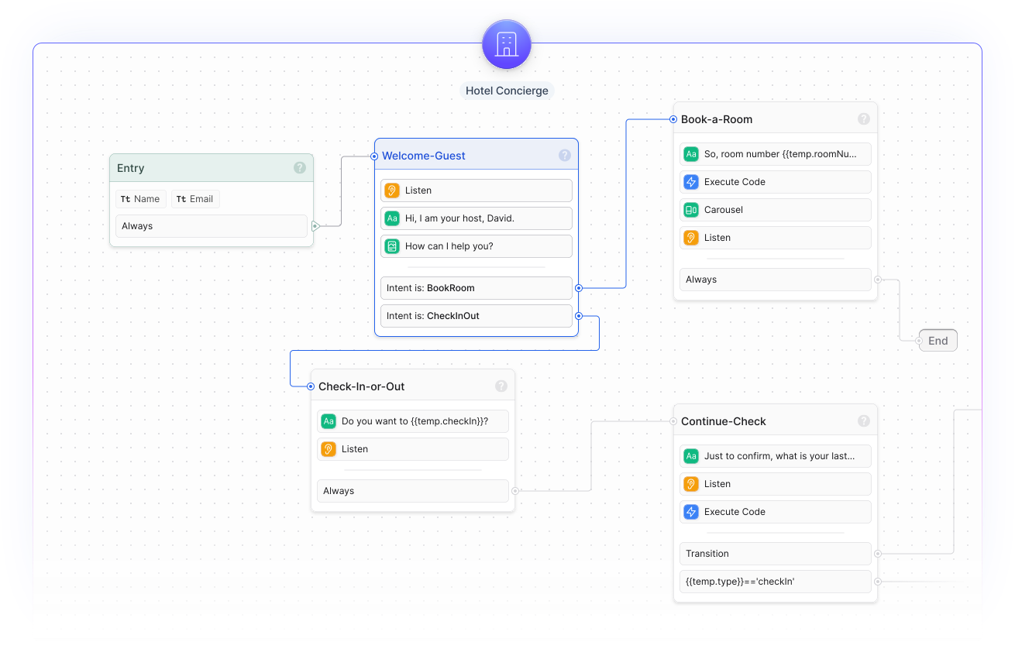
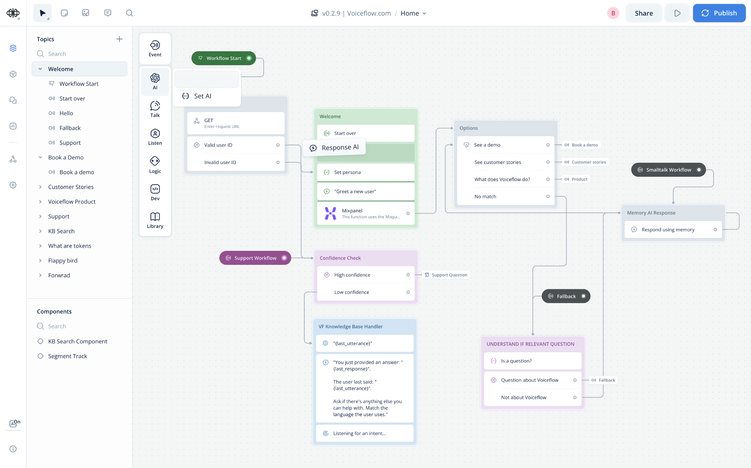

Slide 34
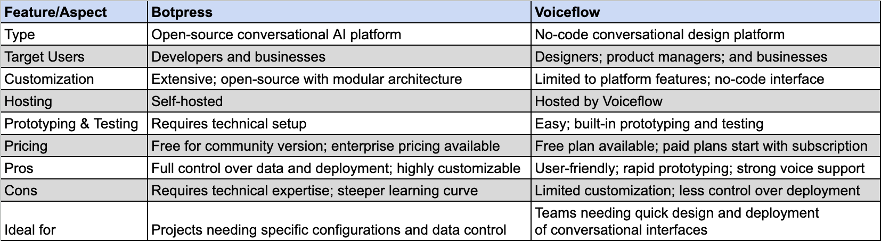
Chatbot Builders

Slide 35
Toolkit Overview
Prototyping
Chatbot Builders
Integration Tools
Custom Code

Slide 36
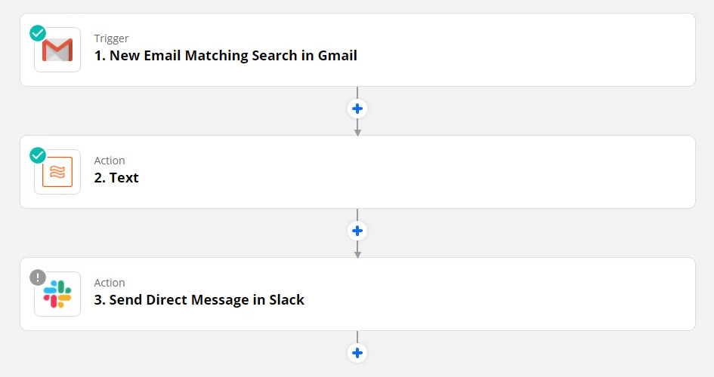
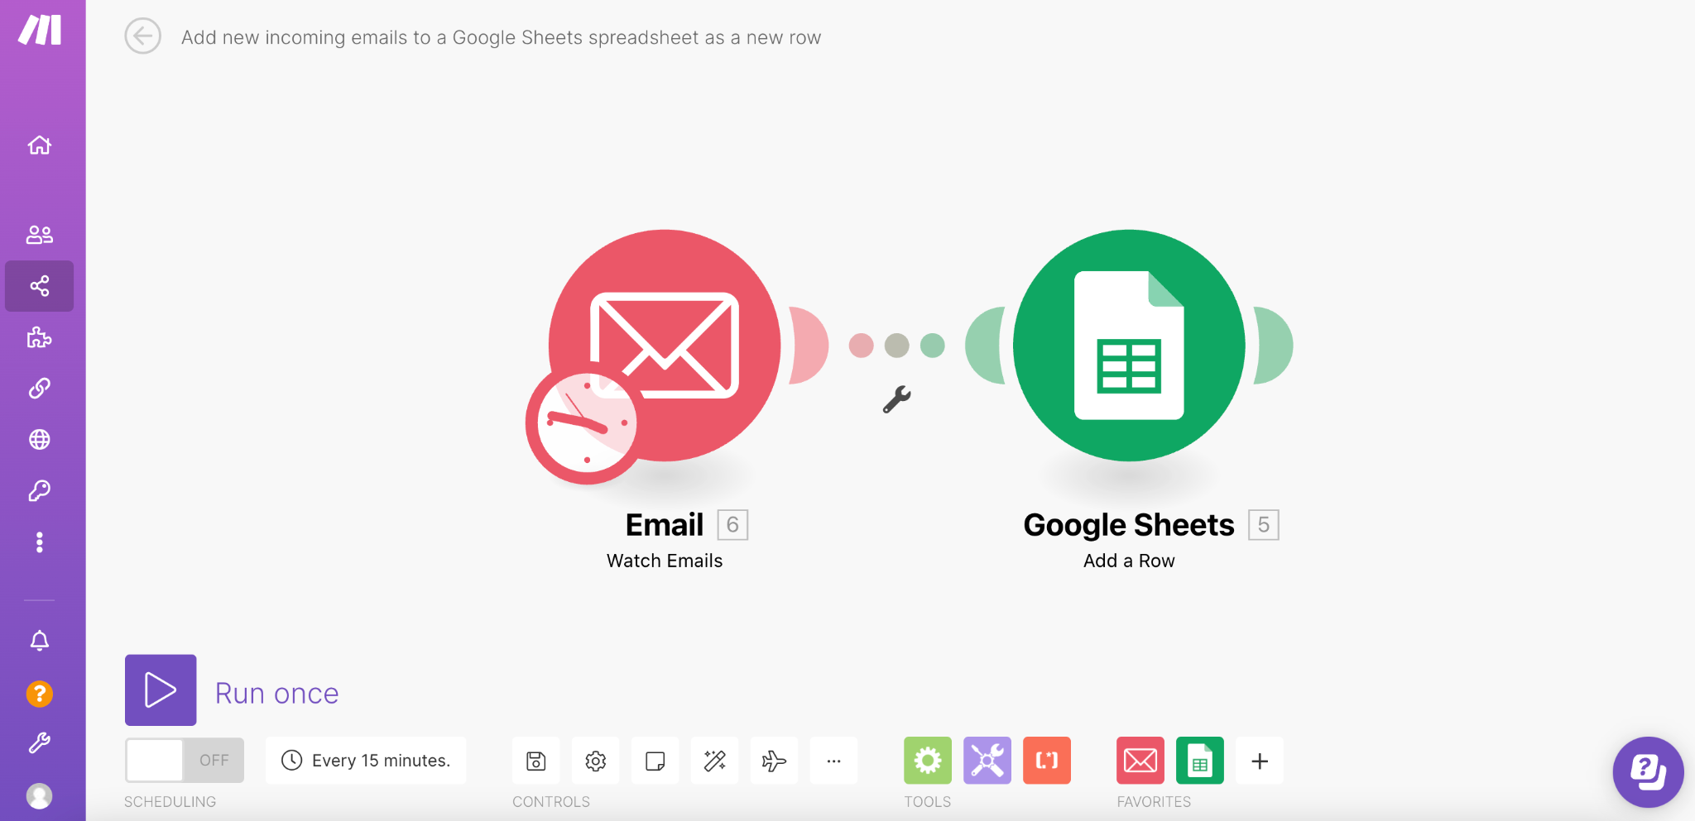

Slide 37
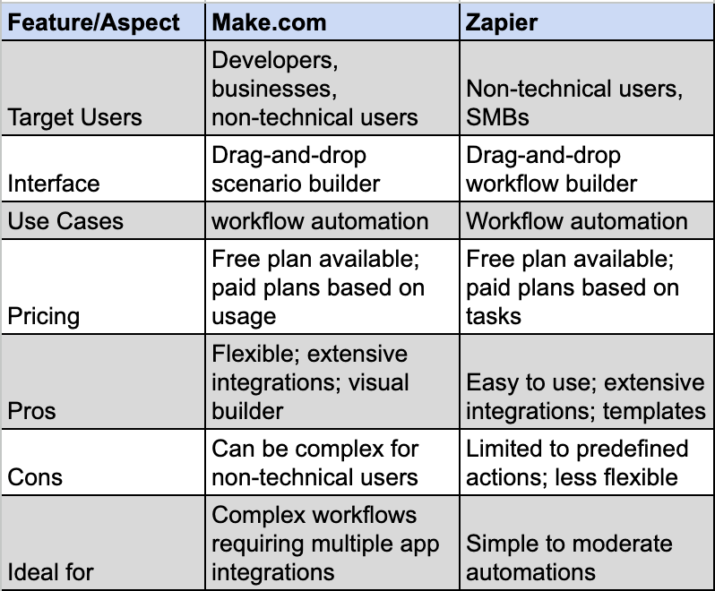

Slide 38
Chatbots to CRM for data entry
Syncing orders to inventory
Automating support tickets from chatbots
Consolidating data into one report
Sharing blog posts on social media
Capturing Facebook leads to CRM
Creating tasks from emails or forms
Sending welcome emails to new leads

Slide 39
Toolkit Overview
Prototyping
Chatbot Builders
Integration Tools
Custom Code

Slide 40
Custom Code
Node.js - to run JavaScript code on servers and build command line tools.
Amazon S3 - to store and retrieve any amount of data with high scalability and security.
AWS Lambda - to run your code automatically in response to events without managing servers.
LLRT - to make your JavaScript code run faster and cheaper on AWS Lambda.

Slide 41
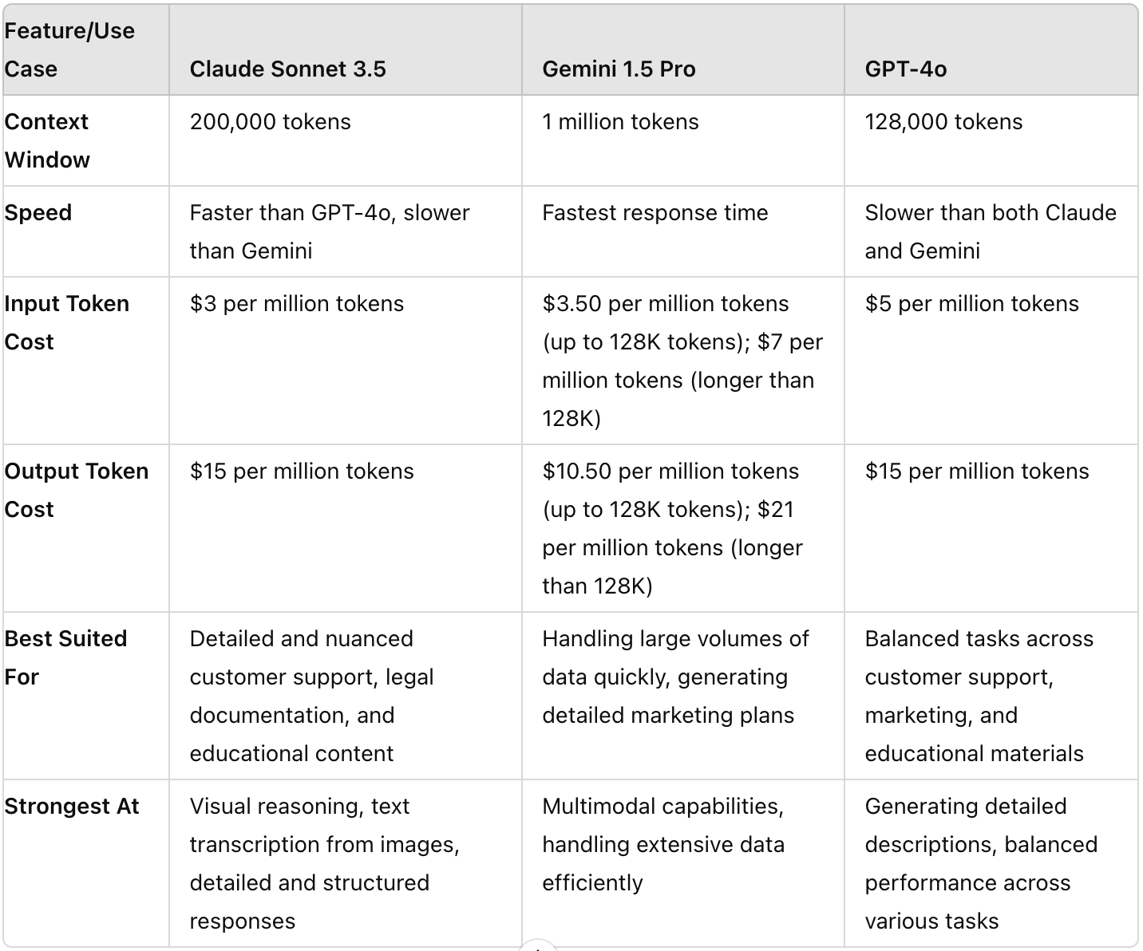
LLM comparison

